Slide 1
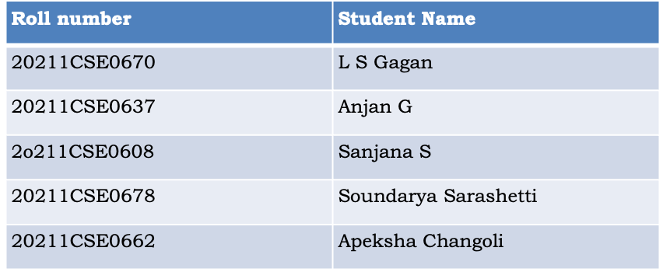
University Project-II
Final review
“Mobile App for Direct Market Access for Farmers”
Batch Number:CSE-G51
Under the Supervision of
Mr. Syed Mohsin Abbasi
Professor
School of Computer Science & Engineering
Presidency University

Slide 2
Introduction
Farmers often face challenges in accessing markets, leading to lower income due to middlemen. This gap restricts their ability to sell produce at fair prices.
Create a mobile application that connects farmers directly with consumers and retailers. The app should include features for listing produce, negotiating prices, and managing transactions, thereby reducing dependence on intermediaries.
Expected Solution: A user-friendly mobile platform that enables farmers to showcase their products and connect with buyers directly, enhancing their income potential.

Slide 3
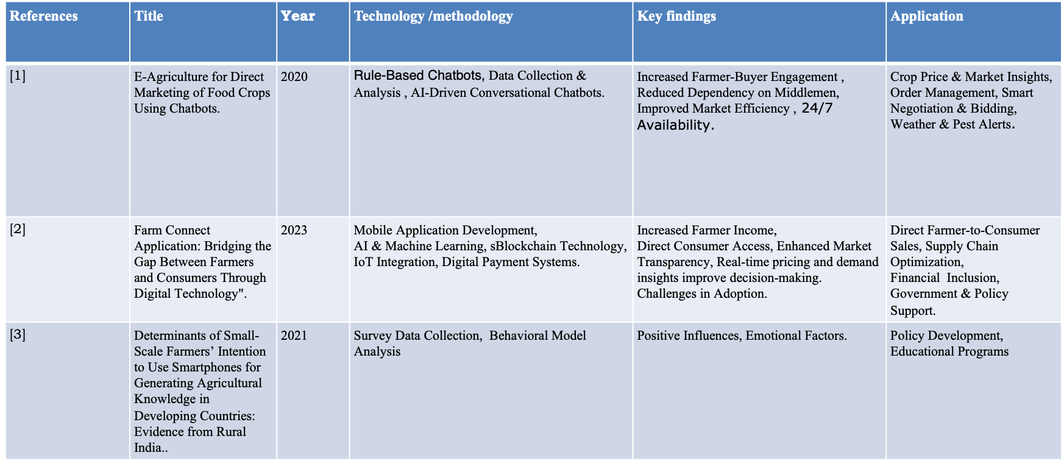
Literature Review

Slide 4
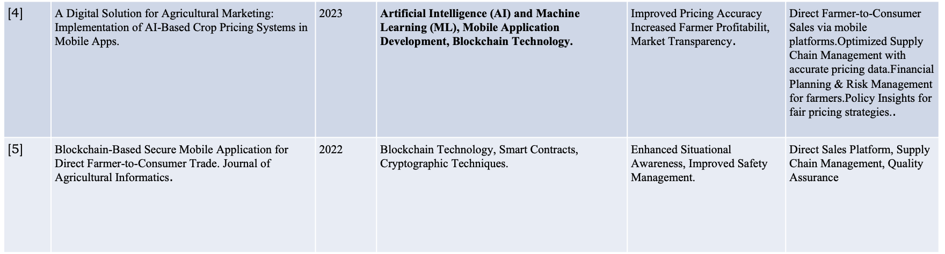

Slide 5
Objectives
Empower Farmers to Sell Directly
Build a platform that removes dependency on middlemen.
Provide Real-Time Market Information
Equip farmers with current market prices, trends, and buyer demand.
Enable Digital Transactions
Support cashless payments, reducing risks and enhancing convenience.
Encourage Sustainable Practices
Support the sale of organic or locally grown produce through visibility and labelling.

Slide 6
Methodology
Requirement Gathering
Collect data on existing market practices and digital literacy levels among farmers.
System Design
Define system architecture, user roles (farmer, buyer, admin), and data flow
Development
Backend setup for secure data storage, real-time pricing updates, and transaction management.
Testing
Performed unit, integration, and system testing to ensure smooth functionality.
User acceptance testing was done with farmers to validate usability and effectiveness.

Slide 7
Methodology
Deployment
Deploy the app on Android platforms.
Training & Support
Conduct workshops or provide video tutorials to train farmers on app usage.
Evaluation & Improvement
Continuously improve features based on real-world usage and emerging needs.

Slide 8
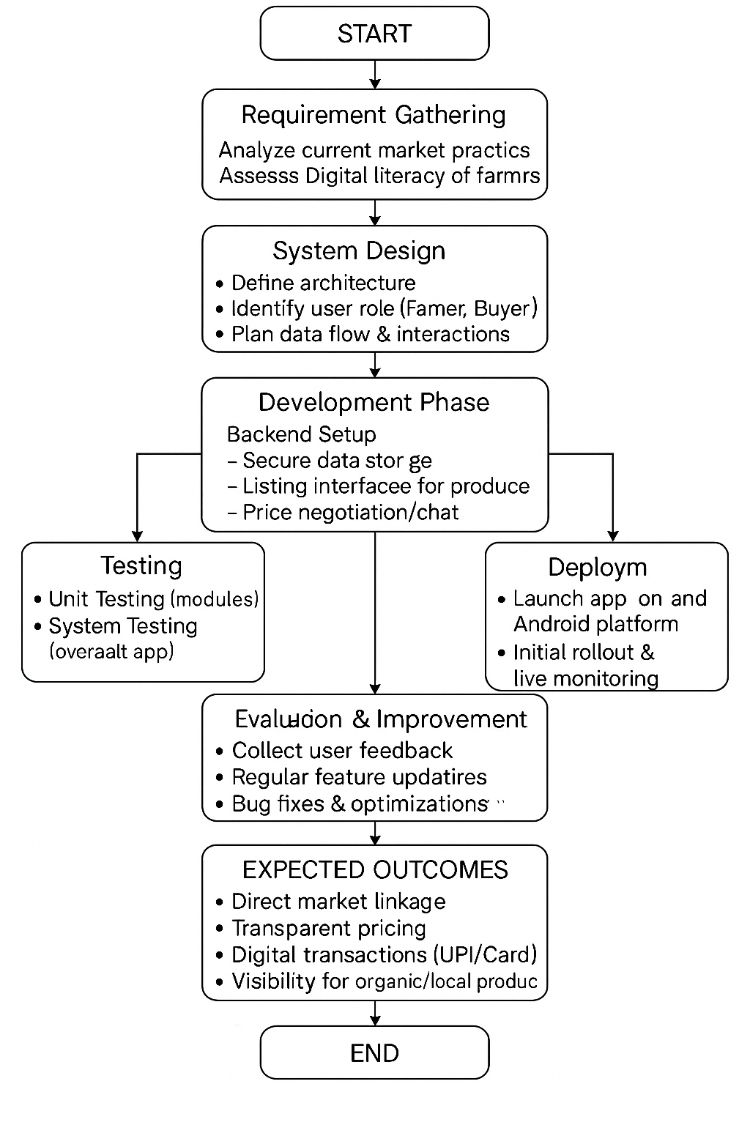

Slide 9
Tools Used
•Frontend: React Native, HTML , CSS and JavaScript
•Backend: Php
•Database: MySQL for data storage.
•Payment Integration: Paytm, Stripe
•Geolocation: Google Maps API

Slide 10
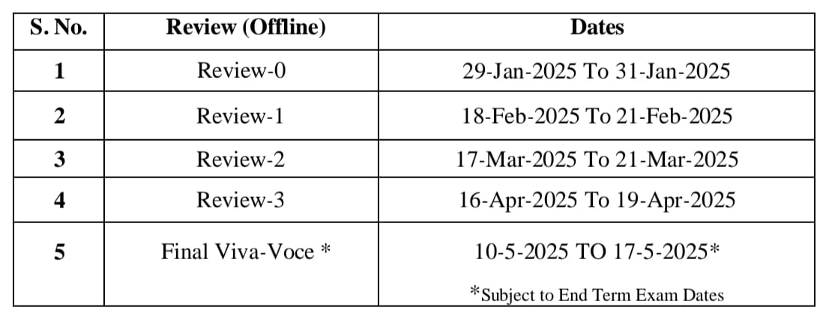
Timeline of Project

Slide 11
Expected Outcomes
Direct Market Linkage Established
Farmers can list products and sell directly to buyers using the mobile app, reducing dependence on traditional channels.
Transparent Pricing System
Farmers gain trust and control by seeing live price updates and buyer offers.
Digital Financial Inclusion
The app supports UPI or card based payments, promoting safe, trackable, and fast transactions.
Support for Organic and Local Produce
Buyers can filter or choose eco-friendly products, boosting visibility and demand for sustainable farming.

Slide 12
Future Scope
Expansion of Farmer Network:
The system aims to increase the number of participating farmers, turning the platform into a large-scale, possibly
national-level connection hub between farmers and consumers.
Agri-Education and Training Modules
Embedding tutorials, news updates, weather forecasts, and farming best practices will empower farmers with
knowledge and real-time insights.
Digital Invoicing & Payment Receipts:
Allow farmers to generate invoices and receive receipts for transactions. Adds transparency and trust to the
transaction process.
Simple Profit Calculator:
A built-in calculator to estimate cost, profit margins, and breakeven points. Encourages better financial planning
and decision-making.

Slide 13
Conclusion
The "Mobile App for Direct Market Access for Farmers" project represents a transformative step toward empowering farmers through technology. By providing a streamlined, user-friendly mobile platform, the project bridges the gap between producers and consumers, reducing the influence of middlemen and ensuring fair pricing.
It facilitates real-time access to market information, demand forecasts, price comparisons, and direct sales opportunities, enabling farmers to make informed decisions and increase their profits.
Moreover, this system promotes transparency, efficiency, and inclusivity in agricultural trade, especially benefiting smallholder farmers in remote areas. As mobile penetration continues to rise globally, especially in rural regions, such platforms have the potential to become essential tools in modern farming.

Slide 14
References
[1]. Usha kruthika, S. S. (2020). E-Agriculture for Direct Marketing of Food Crops Using Chatbots. Chennai,India. doi:10.1109/ICPECTS49113.2020.9337024.
[2]. P, V., P, R., S, K. S., Rao, P. M., & T.A., V. P. (2023). "Farm Connect Application: Bridging the Gap Between Farmers and Consumers Through Digital Technology,". Ghaziabad, India,. doi: 10.1109/ICSEIET58677.2023.10303471.
[3] Landmann, D., Lagerkvist, C. J., & Otter, V. (2021). Determinants of Small-Scale Farmers’ Intention to Use Smartphones for Generating Agricultural Knowledge in Developing Countries: Evidence from Rural India. The European Journal of Development Research, 33, 1435–1454
[4] Gupta, R., & Verma, S. (2023). A Digital Solution for Agricultural Marketing: Implementation of AI-Based Crop Pricing Systems in Mobile Apps. Proceedings of the 10th International Conference on Sustainable Development in Computing Technology.
[5]. Sharma, P., & Kaur, R. (2022). Blockchain-Based Secure Mobile Application for Direct Farmer-to-Consumer Trade. Journal of Agricultural Informatics, 13(2), 75-89. DOI: 10.17700/jai.2022.13.2.659.

Slide 15
Thank You

